Slide 1
Nurturing grassroots night shelters

Slide 2
Introduction
What is the winter night shelter network and what is its current impact?
Who uses winter night shelters?
What barriers do these people face in moving on from rough sleeping?

Slide 3
Overview of the network
145 night shelter projects across England and Wales, compared to 60 projects in 2014
Evolving and maturing network
This equates to approximately 2000 beds, 13,000 nights, or 26,100,000 bed nights, making it one of the largest providers of emergency beds for people experiencing homelessness
.

Slide 4
Equipping Shelters London: 2018-19 Key findings
55% of winter night shelters opened in January, 45% opened pre-Christmas
770 beds in total
62% use the rotating model and 33% use the static model
2,900 guests in 2018/19

Slide 5
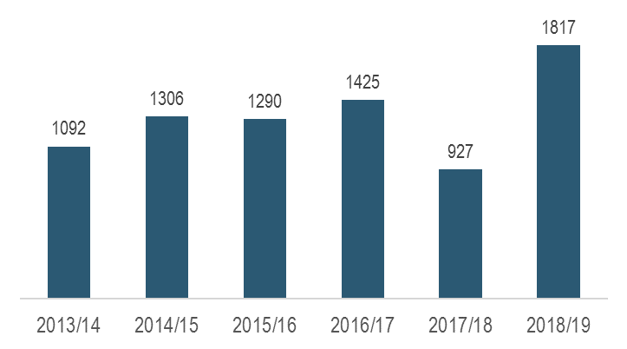
Guest numbers

Slide 6
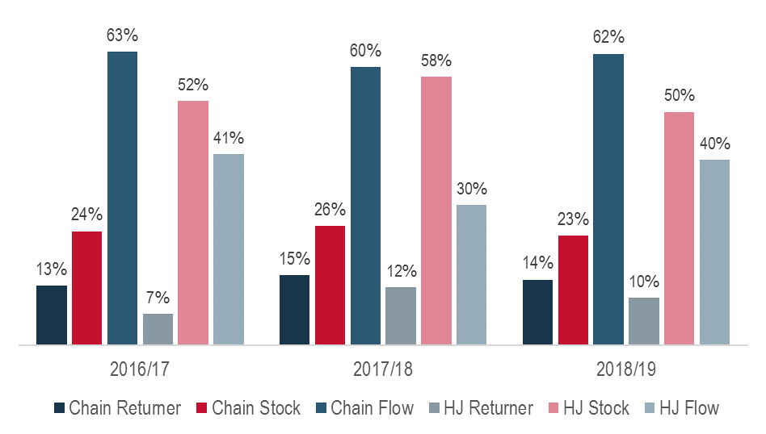
Returner vs Stock vs Flow

Slide 7
A typical case
“A was a 64-year-old Romanian man who had been in the country for 20 years and was known to local outreach and night shelter volunteers and staff.
He was an alcoholic in poor physical health and had no documentation (his passport and other belongings had been stolen whilst he was rough sleeping).
The night shelter caseworker visited the Embassy 3 or 4 times and eventually found a way to proceed. She got his passport number and then the Embassy sent (a request for) clarification of citizenship from the Romanian Ministry of the Interior.
With this, the caseworker was able to get a copy birth certificate and then a temporary passport.”

Slide 8
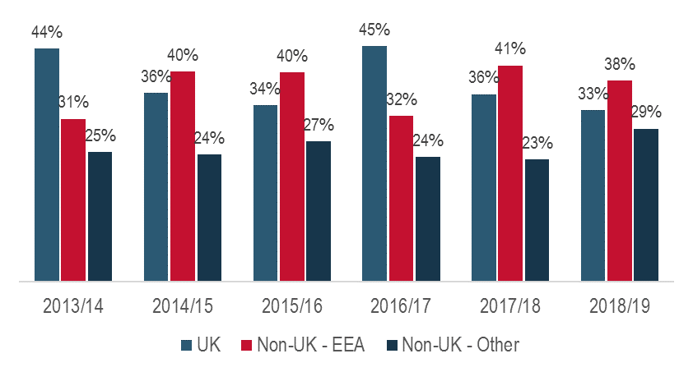
Nationality Split

Slide 9
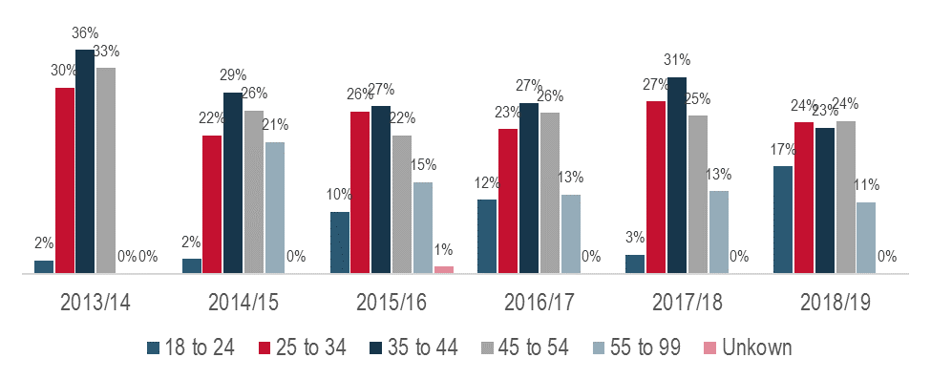
Age profile

Slide 10
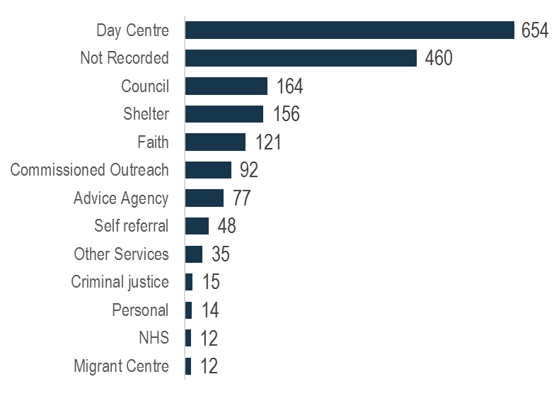
Referral agencies

Slide 11
Move on
82% of guests were in case management in 2018/19, compared to 51% in 2013/14. Move on rates are stubbornly around 40% and show little change
Good quality case management is integral to achieving move on. Casework and the tracking of that casework is paramount
Emerging evidence from projects studied suggests that six weeks was the notional period required to move someone into accommodation when the case is not too complex and relevant supporting documentation is readily available

Slide 12
Key barriers
Immigration status and advice
Engagement and personal wellbeing
Access to secure work or welfare support

Slide 13
Questions?
Email: j.quagliozzi@housingjustice.org.uk
Tel. 07807096824
Twitter @jacobquagliozzi

